Slide 1

UNIVERSITY INSTITUTE OF ENGINEERING
COMPUTER SCIENCE ENGINEERING
Bachelor of Engineering (Computer Science & Engineering)
Subject Name: Block chain Technology
Subject Code: 20_CST-412
Public key crypto
Mapped with CO4
Prepared By:
Er. Ankita Sharma
DISCOVER . LEARN . EMPOWER

Slide 2
Cryptography
Cryptography is technique of securing information and communications through use of codes so that only those person for whom the information is intended can understand it and process it. Thus preventing unauthorized access to information. The prefix “crypt” means “hidden” and suffix “graphy” means “writing”.

Slide 3
Definition
Public-key cryptography, or asymmetric cryptography, is a cryptographic system that uses pairs of keys. Each pair consists of a public key (which may be known to others) and a private key (which may not be known by anyone except the owner).
OR
Public key cryptography involves a pair of keys known as a public key and a private key (a public key pair), which are associated with an entity that needs to authenticate its identity electronically or to sign or encrypt data.
Each public key is published and the corresponding private key is kept secret. Data that is encrypted with the public key can be decrypted only with the corresponding private key.

Slide 4
Public key cryptography enables the following:
Encryption and decryption, which allow two communicating parties to disguise data that they send to each other.
The sender encrypts, or scrambles, the data before sending it. The receiver decrypts, or unscrambles, the data after receiving it. While in transit, the encrypted data is not understood by an intruder.
Nonrepudiation, which prevents:
The sender of the data from claiming, at a later date, that the data was never sent
The data from being altered.

Slide 5
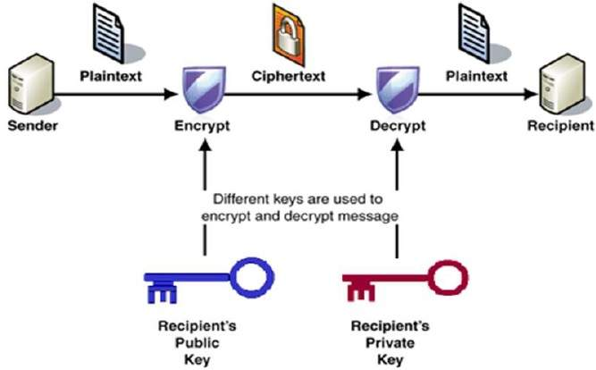

Slide 6
The process for sending and receiving data via asymmetric cryptography typically consists of five steps:
Key generation. Each individual generates a public and private key.
Key exchange. The sender and recipient exchange public keys.
Encryption. The sender's data is encrypted using the recipient's public key.
Sending encrypted data. The encrypted data is sent to the recipient.
Decryption. The recipient decrypts the message using their own private key.

Slide 7
Key Generation
Each person or a party who desires to participate in communication using encryption needs to generate a pair of keys, namely public key and private key.
The process followed in the generation of keys is described below −
Generate the RSA modulus (n)
Select two large primes, p and q.
Calculate n=p*q. For strong unbreakable encryption, let n be a large number, typically a minimum of 512 bits.
Find Derived Number (e)
Number e must be greater than 1 and less than (p − 1)(q − 1).
There must be no common factor for e and (p − 1)(q − 1) except for 1. In other words two numbers e and (p – 1)(q – 1) are coprime.
Form the public key
The pair of numbers (n, e) form the RSA public key and is made public.
Interestingly, though n is part of the public key, difficulty in factorizing a large prime number ensures that attacker cannot find in finite time the two primes (p & q) used to obtain n. This is strength of RSA.
Generate the private key
Private Key d is calculated from p, q, and e. For given n and e, there is unique number d.
Number d is the inverse of e modulo (p - 1)(q – 1). This means that d is the number less than (p - 1)(q - 1) such that when multiplied by e, it is equal to 1 modulo (p - 1)(q - 1).
This relationship is written mathematically as follows :− ed = 1 mod (p − 1)(q − 1)

Slide 8
Example
An example of generating RSA Key pair is given below.
(For ease of understanding, the primes p & q taken here are small values. Practically, these values are very high).
Let two primes be p = 7 and q = 13. Thus, modulus n = pq = 7 x 13 = 91.
Select e = 5, which is a valid choice since there is no number that is common factor of 5 and (p − 1)(q − 1) = 6 × 12 = 72, except for 1.
The pair of numbers (n, e) = (91, 5) forms the public key and can be made available to anyone whom we wish to be able to send us encrypted messages.
Input p = 7, q = 13, and e = 5 to the Extended Euclidean Algorithm. The output will be d = 29.
Check that the d calculated is correct by computing −
de = 29 × 5 = 145 = 1 mod 72
Hence, public key is (91, 5) and private keys is (91, 29).

Slide 9
Encryption and Decryption
RSA Encryption
Suppose the sender wish to send some text message to someone whose public key is (n, e).
The sender then represents the plaintext as a series of numbers less than n.
To encrypt the first plaintext P, which is a number modulo n. The encryption process is simple mathematical
step as −
C = P^{e} mod n
In other words, the ciphertext C is equal to the plaintext P multiplied by itself e times and then reduced modulo n.
This means that C is also a number less than n.
Returning to our Key Generation example with plaintext P = 10, we get ciphertext C −
C = 10⁵ mod 91

Slide 10
RSA Decryption
The decryption process for RSA is also very straightforward. Suppose that the receiver of public-key pair (n, e) has received a ciphertext C.
Receiver raises C to the power of his private key d. The result modulo n will be the plaintext P.
Plaintext = C^{d} mod n
Returning again to our numerical example, the ciphertext C = 82 would get decrypted to number 10 using private key 29 −
Plaintext = 82²⁹ mod 91 = 10

